Slide 1


Team 1 Aniket Patil Dipali Patil Mamta Jeswani Rutuja Deshmukh Shubham Nagpure
P166 – Apple Stock Price Forecast
Mentor – Neha Gupta
09/12/2022

Slide 2
Index
Introduction
Objectives
EDA
Visualization
Model Building
Prediction

Slide 3

Introduction
Stock market is an aggregation stockbrokers and traders who can buy and sell shares of stocks.
Stock data is non-stationary, chaotic, random and depends on several technical parameters.
Since statistical approaches are linear in nature, it hampers prediction performances in case of sudden rise or fall of prices of the stocks.
In modern days of artificial intelligence, machine learning plays an important role in time series predictions.

Slide 4

Apple Inc. is an American multinational technology company headquartered in Cupertino, California, United States.
Apple is the largest technology company by revenue (totaling US$365.8 billion in 2021).
As of June 2022, it’s the world's biggest company by market capitalization.
The fourth-largest personal computer vendor by unit sales and second-largest mobile phone manufacturer.
It is one of the Big Five American information technology companies, alongside Alphabet, Amazon, Meta, and Microsoft.

Slide 5
BUSINESS PROBLEM
To predict the price of Apple stock for next 30 days on the basis of given data.
BUSINESS OBJECTIVE
Predict the stock price of APPLE for next 30 days on the basis of given data.
Build a model to predict the price for the said period by splitting the data into train and test set.
Find trends in short term and long term.
Impact of external factors or any events.

Slide 6
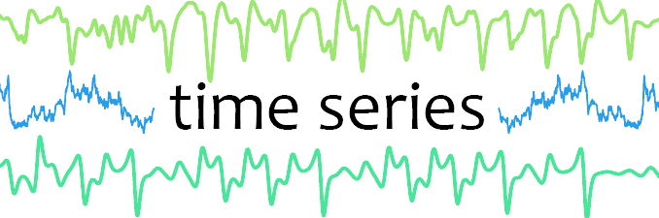
Methodologies
ARIMA
SARIMA
HOLT – Winter Method
EMA

Slide 7
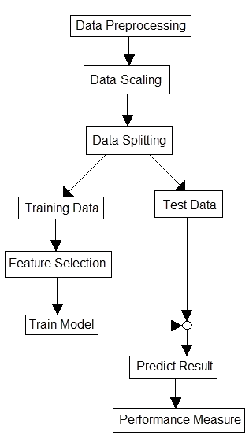
PROJECT WORK FLOW

Slide 8
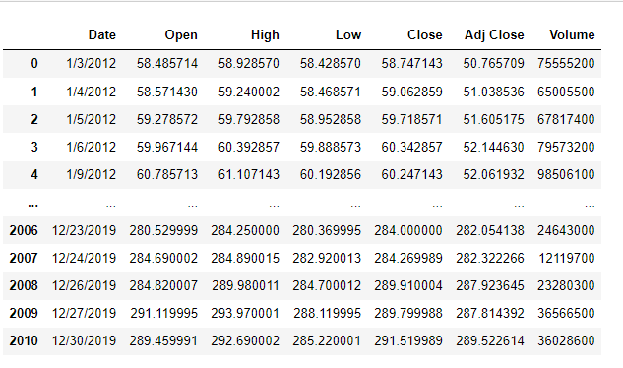
DATA SET
The data used in this project consists of the historical stock prices of AAPL obtained via Yahoo Finance.
Data set contains the following variables; Date (January 2012 - December 2019), Open, High, Low, Close, Adjusted Close and Volume.
Open : The opening price of that day.
High : The highest price that Apple stocks were negotiated that day.
Low : The lowest price that Apple stocks were negotiated that day.
Close : The last price negotiated for Apple stocks that day.
Adj Close: The Adjusted Closing Price for Apple stocks that day.
Volume: Total financial volume of all negotiations that were made in that specific day.

Slide 9
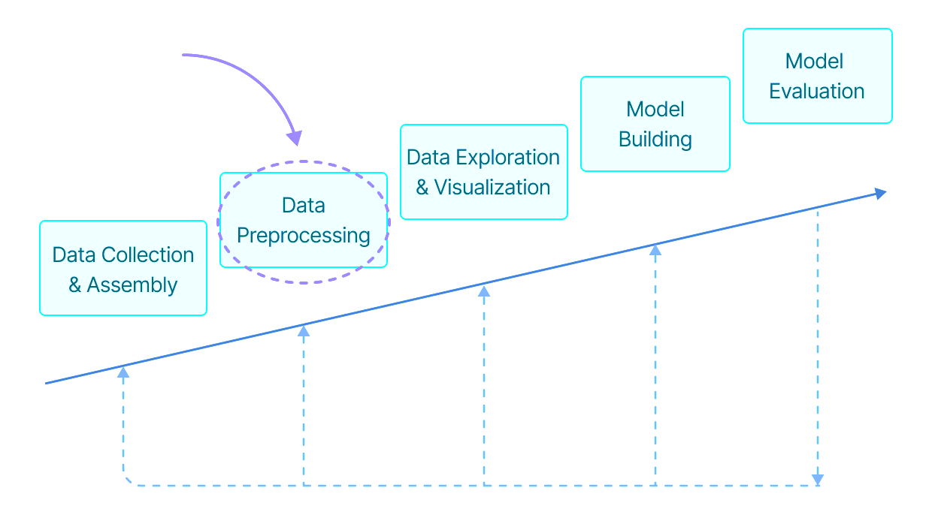
Data Preprocessing
Data has 7 columns - ‘Date', 'Open', 'High', 'Low', 'Close', 'Adj Close', 'Volume’
It has float and integer values and is in Object type.
There are no null values in the data.
There are no duplicates in the data.
Data is correlated.

Slide 10

EXPLORATORY DATA ANALYSIS & FEATURE ENGINEERING
Exploratory Data Analysis is an approach to analyzing data sets to summarize their main characteristics, often with visual methods.
EDA allows us to get an initial feel for the data.
This lets us determine if the data makes sense, or if further cleaning or more data is needed.
It helps to identify patterns and trends in the data.
Feature engineering is the process of using domain knowledge of the data to create features that make machine learning algorithms work.
TECHINIQUES OF EDA
Summary Statistics (Average, Median, Mean, Min, Max, Correlations, etc. )
Visualizations (Histograms, Scatter Plots, Box Plots, etc.)
TOOLS FOR EDA
Data Wrangling (Pandas)
Visualization (Matplotlib, Seaborn)

Slide 11
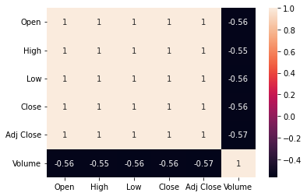
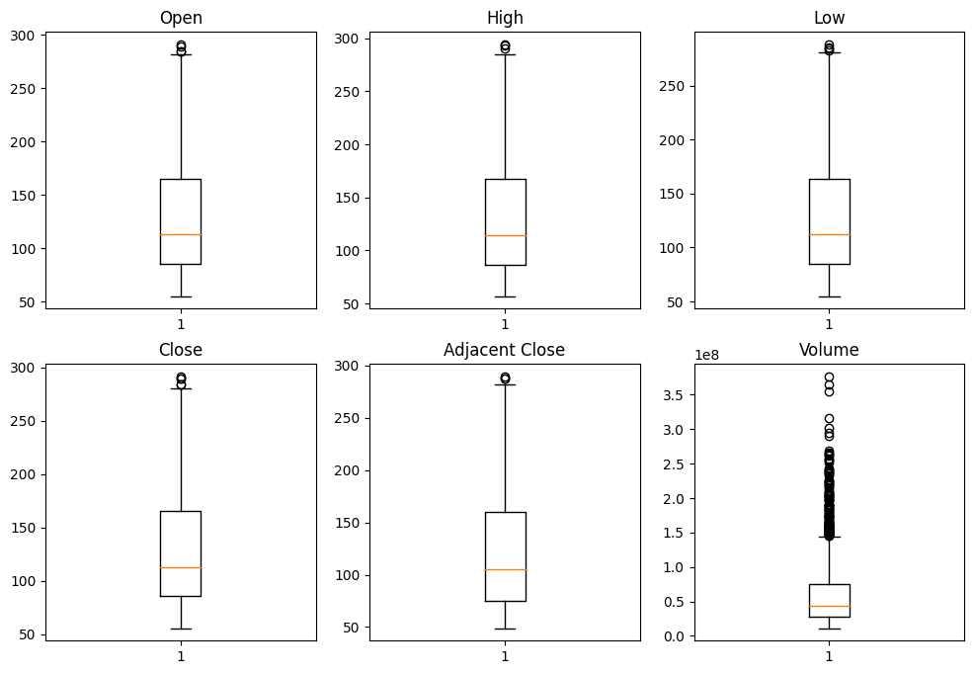
EDA Visualization
HEATMAP
BOXPLOT (OR BOX-AND-WHISKER PLOT)

Slide 12
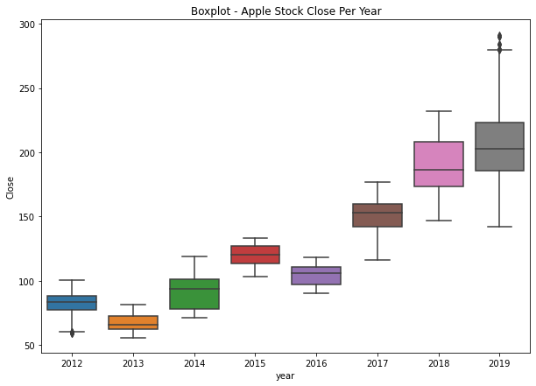
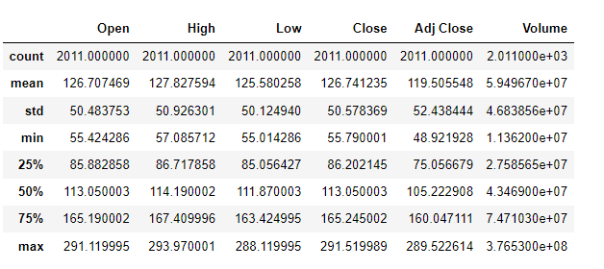
EDA Visualization (Continued)
BOXPLOT – CLOSE PRICE
DESCRIPTIVE STATISTICS

Slide 13
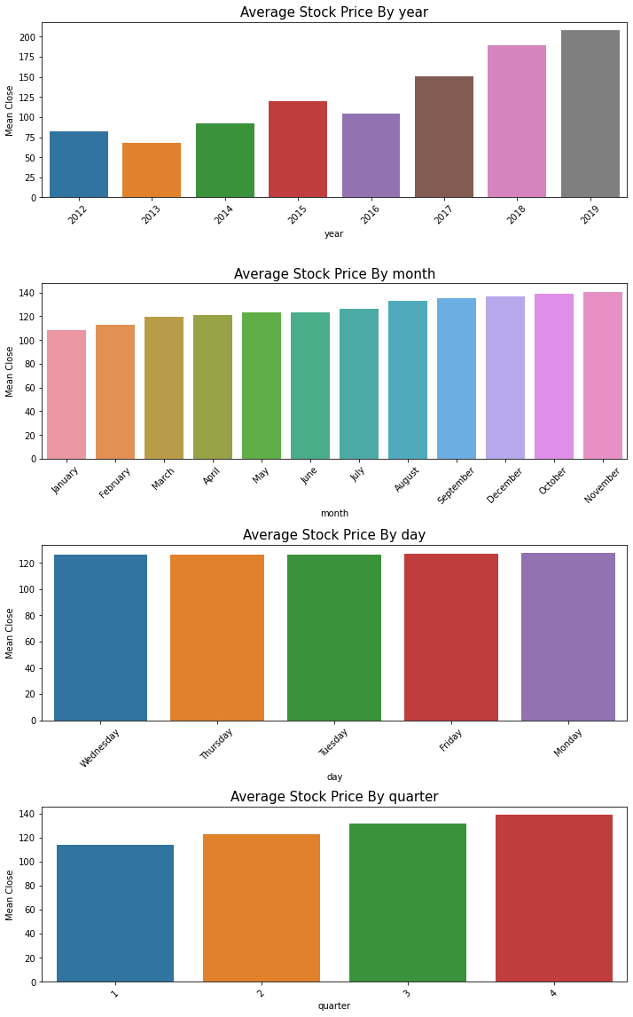
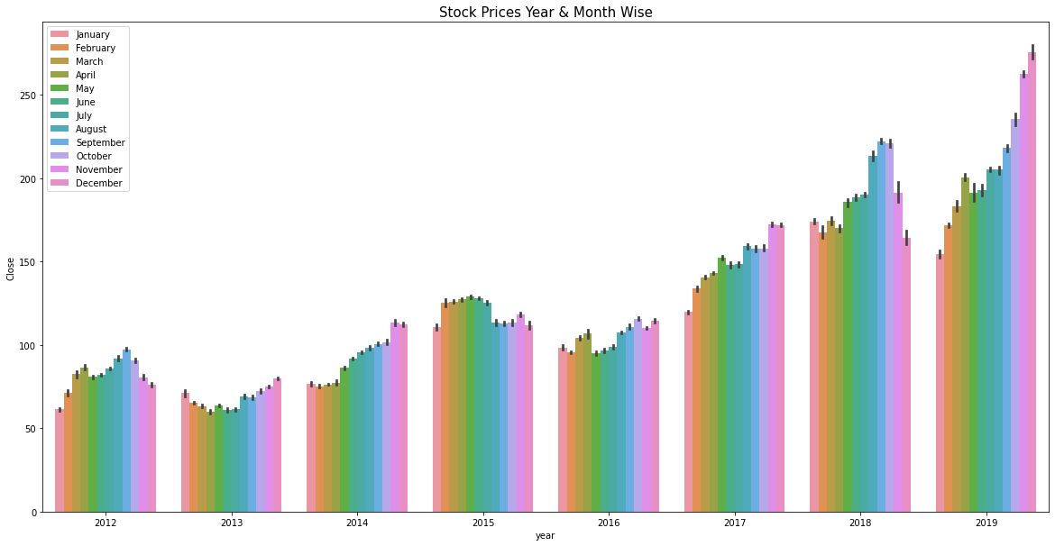
EDA Visualization (Continued)
AVERAGE STOCK PRICE BY
STOCK PRICES YEAR & MONTH WISE

Slide 14
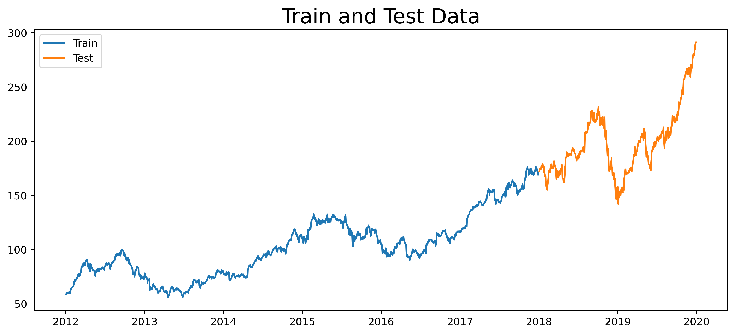
Data Splitting
Dataset has been divided into two parts –
Train Data – 2012-02-03 to 2017-12-29
Test Data – 2018-01-02 to 2019-12-30

Slide 15
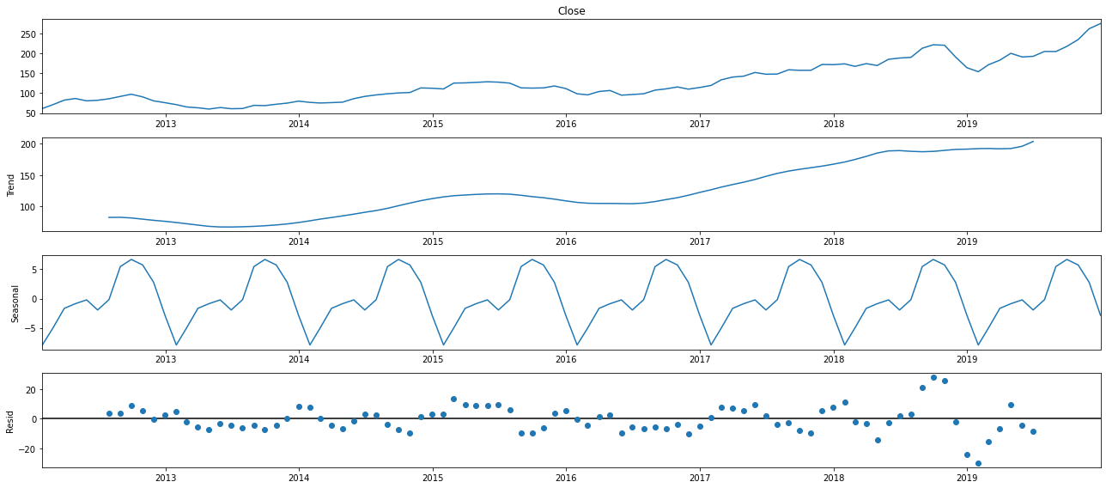
Decomposition of time series

Slide 16
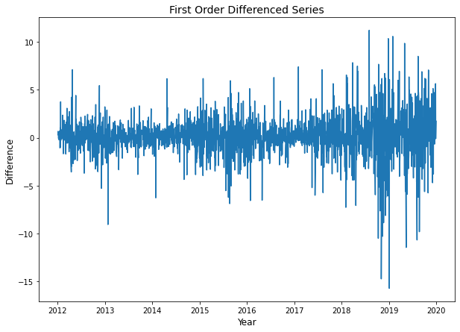
Differencing
ADF TEST ON TOTAL DATA
ADF Test Statistic : 1.2193479467002406
p-value : 0.9961168706935021
#Lags Used : 9
Number of Observations used : 2001
Accept Null Hypothesis. Data is Non – Stationary
***************
ADF Test Statistic : -13.62553837607382
p-value : 1.7630934279439484e-25
#Lags Used : 8
Number of Observations used : 2001
Reject Null Hypothesis. Data is Stationary

Slide 17
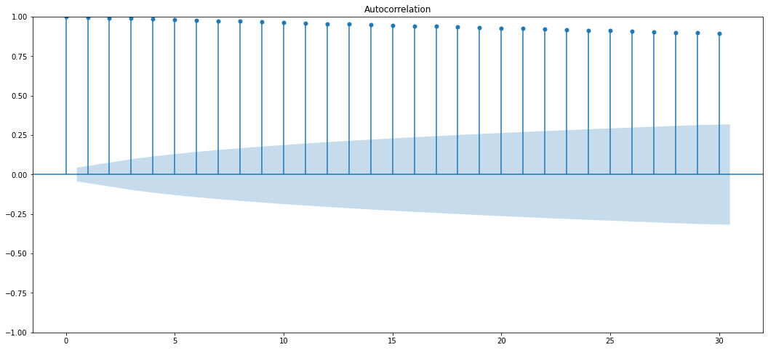
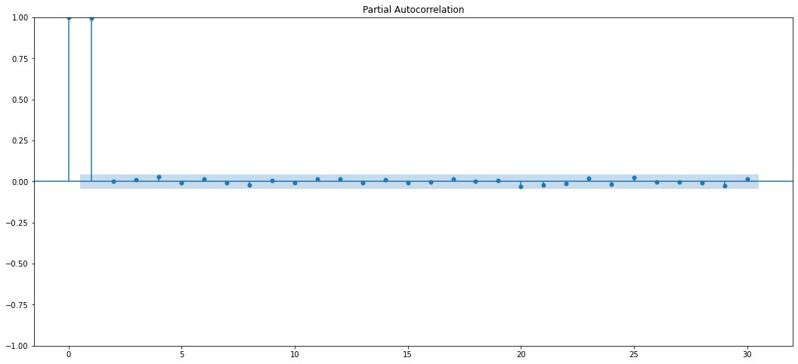
ACF plots and PACF plots
ACF PLOT
PACF PLOT
Interpreting ACF Plot:
Slow decay of correlation values indicates that future values are heavily dependent on lagged values.
This shows that series in not random and good for time series modelling.
Interpreting PACF Plot:
Sudden Decay at Lag-1, Order of series seems AR(1)
Here we can see that the first lag is significantly out of the limit and the second one is also out of the significant limit but it is not that far so we can select the order of the p as 1.
Order Of Differencing is 1
p=1, d=1, q=1

Slide 18

ARIMA
ARIMA – Auto Regression Integrated Moving Average Model.
It goes through differencing steps to eliminate the non-stationary part.
ARIMA Models are specified by three order parameters: (p, d, q),
where,
- p is the order of the AR term
- q is the order of the MA term
- d is the number of differencing required to make the time series stationary
An ARIMA model is one where the time series was differenced at least once to make it stationary and we combine the AR and the MA terms. So the equation of an ARIMA model becomes :

Slide 19
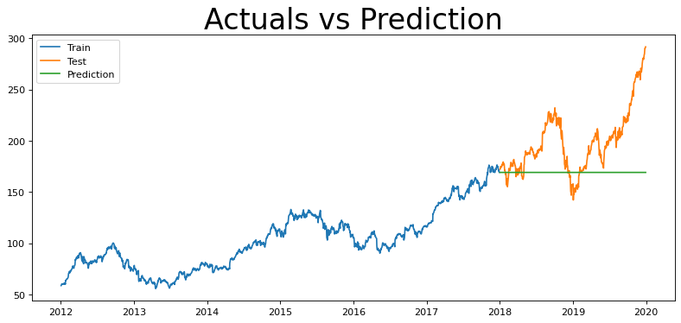
ARIMA (Continued..)
(1,1,1)
MODEL PARAMETER SUMMARY
Order | RMSE | MAPE | AIC | BIC
(2,1,2) | 41.66 | 0.186209753 | 5590.958 | 5617.551
(0,1,0) | 41.69 | 0.186468921 | 5592.981 | 5598.3
(1,1,1) | 41.72 | 0.18670157 | 5595.408 | 5611.363
(0,1,1) | 41.72 | 0.18675199 | 5593.898 | 5604.535
(1,1,0) | 41.72 | 0.186738612 | 5593.97 | 5604.607
(3,1,2) | 41.72 | 0.186726995 | 5595.41 | 5627.322
(7,1,4) | 41.78 | 0.187168596 | 5604.782 | 5668.604
(5,1,1) | 41.78 | 0.187173087 | 5600.775 | 5638.005
(0,0,0) | 100.12 | 0.929387959 | 14432.896 | 14443.534
Mean Squared Error (MSE) = 1740.4872578072632
Root Mean Squared Error (RMSE) = 41.72
Mean Absolute Error (MAE) = 31.589529229938087
Mean Absolute Percentage Error (MAPE) = 0.1867155255477968

Slide 20
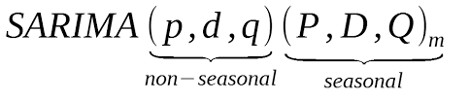
sARIMA
An extension to ARIMA that supports the direct modeling of the seasonal component of the series is called SARIMA - Seasonal Autoregressive Integrated Moving Average.
There are four seasonal elements that are not part of ARIMA that must be configured; they are:
P: Seasonal autoregressive order.
D: Seasonal difference order.
Q: Seasonal moving average order.
m: The number of time steps for a single seasonal period.

Slide 21
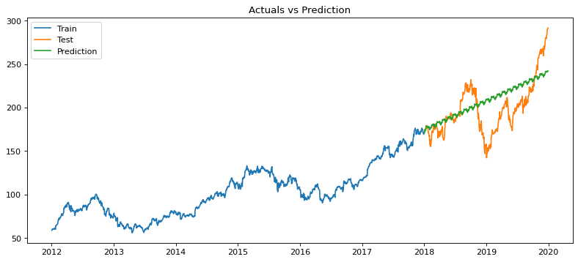
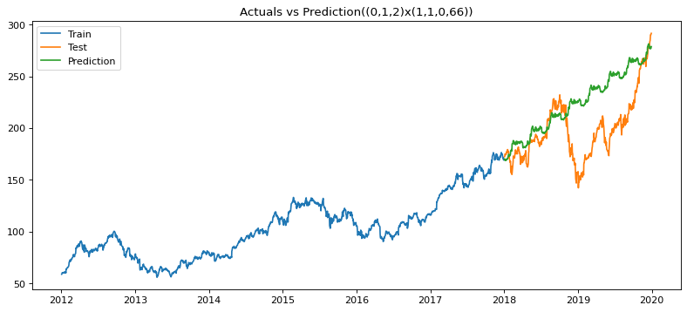
sarima
(0, 1, 2) x (1, 1, 0, 22)
Order | RMSE | MAPE | AIC | BIC
(0, 1, 2) x (1, 1, 0, 22) | 24.86 | 0.094798073 | 6159.171 | 6180.387
(1, 1, 1) x (0, 1, 1,66 ) | 26.59 | 0.102348962 | 5581.35 | 5602.445
(0, 1, 1) x (0, 1, 1, 66) | 26.59 | 0.102366682 | 5579.685 | 5595.506
(0, 1, 2) x (1, 1, 1, 22) | 26.64 | 0.102443732 | 5615.706 | 5642.225
(0, 1, 1) x (0, 1, 2, 22) | 26.68 | 0.102669109 | 5614.862 | 5636.077
(1, 1, 1) x (0, 1, 1, 22) | 26.77 | 0.103236624 | 5618.986 | 5640.201
(0, 1, 1) x (0, 1, 1,22) | 26.78 | 0.103263857 | 5617.46 | 5633.372
(0, 1, 2) x (1, 1, 1, 5) | 26.84 | 0.103656467 | 5608.674 | 5635.25
(1, 1, 1) x (0, 1, 1, 5) | 26.85 | 0.103685433 | 5607.932 | 5629.193
(0, 1, 1) x (0, 1, 1, 5) | 26.85 | 0.103713639 | 5606.452 | 5622.397
(0, 1, 1) x (0, 1, 2, 5) | 26.87 | 0.10382165 | 5608.395 | 5629.655
(0, 1, 2) x (1, 1, 1, 66) | 26.87 | 0.103913146 | 5580.69 | 5607.059
(0, 1, 1) x (0, 1, 2, 66) | 26.94 | 0.104281653 | 5579.666 | 5600.761
(0, 1, 2) x (1, 1, 0, 66) | 36.42 | 0.122709843 | 6040.232 | 6061.327
(0, 1, 2) x (1, 1, 0, 5) | 203.74 | 19.95183142 | 6167.292 | 6188.553
(1,1,1) x (1, 1, 1, 5) | 26.83 | 0.103574486 | 5610.108 | 5636.684
(1,1,1) x (1, 1, 1, 22) | 26.66 | 0.102549963 | 5616.532 | 5643.051
(1,1,1) x (1, 1, 1, 66) | 26.88 | 0.103967534 | 5581.519 | 5607.888
(1, 1, 1) x (0, 1, 1, 264) | Memory Error
(0, 1, 2) x (1, 1, 0, 66)
Mean Squared Error (MSE) = 719.875817982624
Root Mean Squared Error (RMSE) = 26.83
Mean Absolute Error (MAE) = 19.803936319790104
Mean Absolute Percentage Error (MAPE) = 0.10358102147217879

Slide 22
Holt-wINTERS Method
Holt-Winters is a model of time series behavior. Forecasting always requires a model, and Holt-Winters is a way to model three aspects of the time series: a typical value (average), a slope (trend) over time, and a cyclical repeating pattern (seasonality).

Slide 23
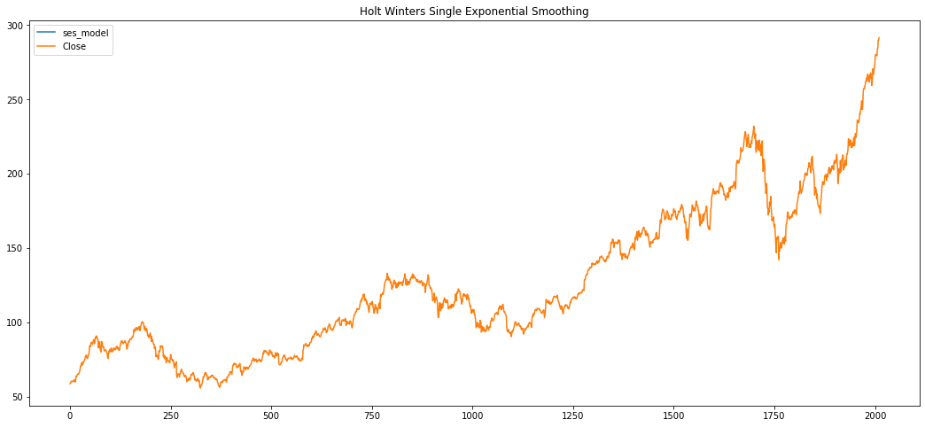
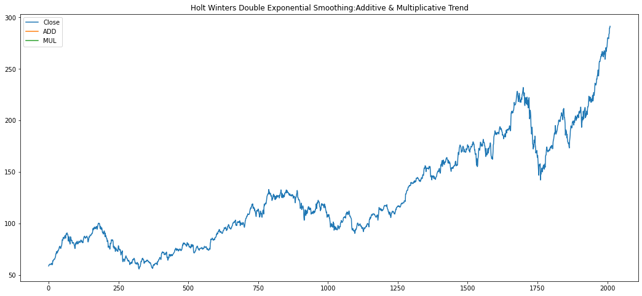
Holt-wINTERS Method
SINGLE/SIMPLE EXPONENTIAL METHOD
DOUBLE HWES
It didn’t fit quite well, and rightfully so, because if we remember, Single ES doesn’t work for data with Trends and Seasonality.

Slide 24
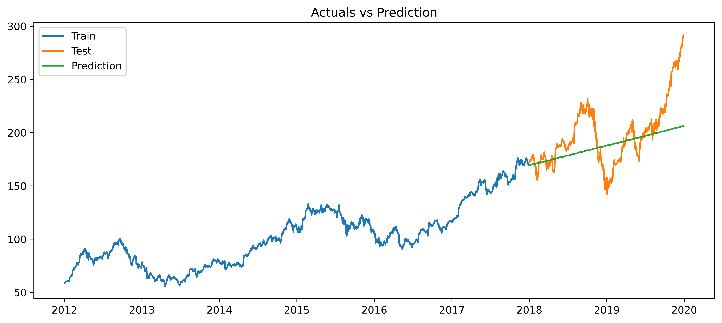
Holt-wINTERS Method
Forecasting with Holt-Winters Exponential Smoothing (Triple ES)
Mean Squared Error (MSE) = 715.627852116288
Root Mean Squared Error (RMSE) = 26.75
Mean Absolute Error (MAE) = 19.73387189833824
Mean Absolute Percentage Error (MAPE) = 0.0938659187124446

